Slide 1

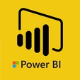
Hii,
Iam Siddhika
Welcome to Power BI Series
Part -69

Slide 2



I’m very excited to dive into this with you all!
Are you ready to enhance your data visualization skills?
We focus only on the most used and important Visuals
Today Content
VISUALIZING DATA
AI VISUALS
SMART NARRATIVE EXPLAIN INCREASE

Slide 3
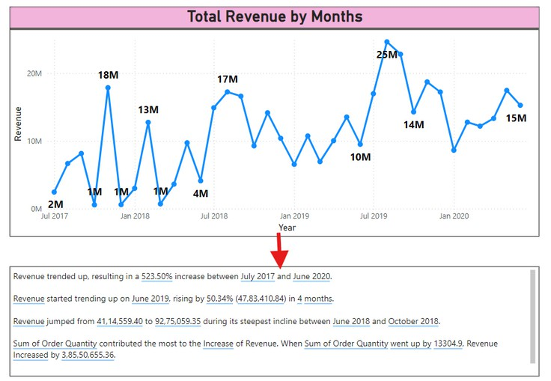

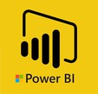
SMART NARRATIVE
check next slide
to setup Smart
Narrative.
The Smart Narrative visual in Power BI automatically generates text-based summaries and insights from your data. It helps users quickly understand key points and trends by providing a narrative explanation of the data visualizations on a report.

Slide 4

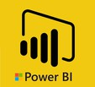

HOW TO SETUP SMART NARRATIVE
Go and exlpore
To get summary for whole page:
Click on the Smart Narrative visual to automatically generate a summary based on the existing visuals on the report.
To get summary for specified visual:
To generate a smart narrative of a visualization, right click it and then select Summarize

Slide 5
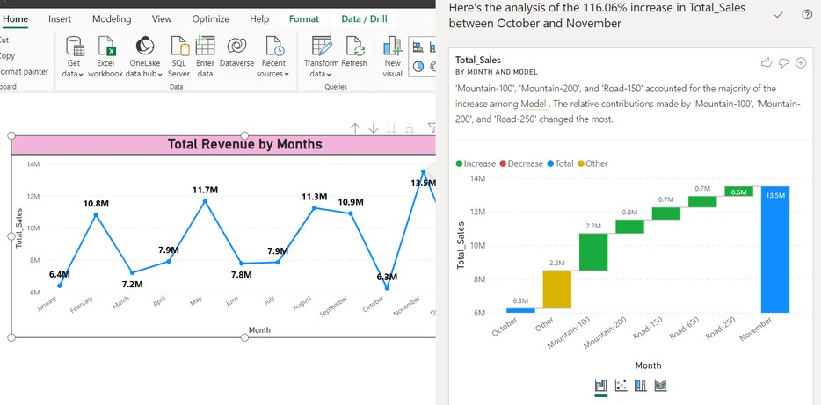

EXPLAIN INCREASE
check next slide
to explain
increase on that
data point.
The "Explain Increase" feature in Power BI is a tool that provides automated insights into why there is an increase (or decrease) in the values of a visual. This feature helps users quickly identify the factors contributing to the change, without manually digging through the data.

Slide 6
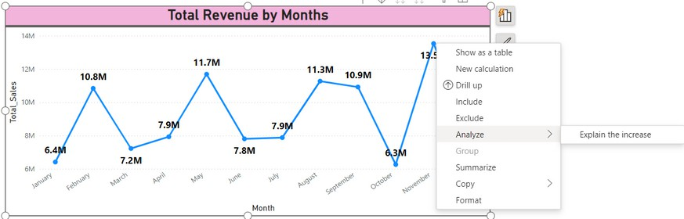

How to Use
Go and explore Explain Increase feature
Locate the visual in your report where you observe a significant increase (or decrease).
Right-click on the data point where you notice the change.
Choose "Analyze" from the context menu.
Click on "Explain the increase" (or "Explain the decrease" if the previous value was higher).
A new window will appear with a detailed analysis explaining the factors contributing to the increase. This analysis may include other dimensions or categories that are driving the change.
_{i}

Slide 7


Thank you for joining me today to learn about Part -69 of Power BI!
Remember, Effective data visualization is crucial for turning data into meaningful insights and compelling narratives with Power BI.
Stay tuned for more insights and tips on Power BI in our next Series.
Follow

